Slide 1

LAB I. R basics

Slide 2
Summary
R (very) basics refresher
Joins
AdventureWorks exercise

Slide 3
Resources
Hands-On Programming with R
Introduction to R, for non-programmers
Free (legally) here: https://rstudio-education.github.io/hopr/
R for Data Science, by Hadley Wickham
Great book to learn R with the tidyverse
Use it once you are comfortable with concepts from the previous book
Free (legally) here: https://r4ds.hadley.nz/

Slide 4
What’s coming (1)
I’ll start with a R programming refresher, about:
Basic R concepts: the interface, objects, environment…
Useful functions
Joins: types and cardinality
If you think you don’t need one, feel free to start the exercise by going to this link: https://github.com/Dscronias/DS-Real-World-Pub
Download the .docx or .pdf (the instructions) and all the data files in “Labs/Lab 1/”

Slide 5
What’s coming (2)
At the end of the class, send me what you have done by email
You’ll get 5 points (out of 20) if you try to do all the exercises
It’s fine if you can’t finish them or do them perfectly (I’m not grading that)
If you are not there during one lab, just send the exercise at some point during the year
I will spend some time reviewing your codes and, near the end of the course, compile some tips for you to improve/errors to avoid

Slide 6
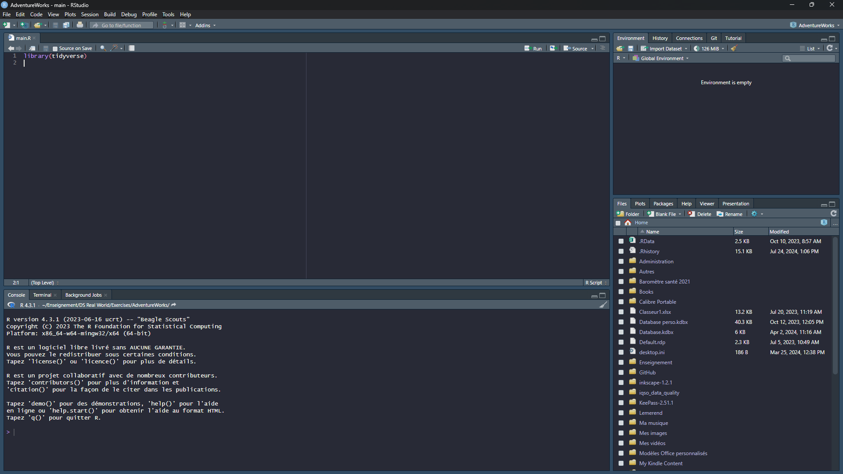
R basics

Slide 7
R basics
Source
Where you write your code, it’s kept in a file
Use it to reproduce what you have done
Console
This is where results are shown
You can enter code there, but it is not saved
Environment
This is where objects are stored

Slide 8
Objects (1)
In R, an object is literally anything that is saved
See it as a storage (some box) for data (its content), it can be:
A number: my_number <- 6
A string (characters): random_string <- “winnterzuko”
A list: some_list <- c(30, 8, “test”, my_number, random_string)
A dataframe
A function: cool_function <- function(var1, y) {var1 + y}
And a lot of other things
You assign data to an object using the <- operator

Slide 9
Objects (2)
You assign data to an object using the <- operator
Let’s say you have the object: my_number <- 6
If you want to modify it, you must reuse the <- operator: my_number <- my_number + 2
Now, my_number is 8
If you had just written: my_number + 2
My_number would still be 6
It’s a common beginner mistake to forget <-
Note: you can use = instead of <-, but it is bad practice
Notes:
We will see what bad practices are in programmation later in the course

Slide 10
Functions, packages (1)
A function is just a sequence of steps to transform data
It has input(s), data that comes in
And output(s), data that comes out
my_function <- function(a, b) {
a + b^2
}
Inputs are a and b. Inside the function, there is a sequence of steps: take the square of input b, add a to it. The output is the result.

Slide 11
Functions, packages (2)
A package will simply be some library in which you have multiple functions, e.g. :
dplyr package: filter(), mutate(), select()…
stats: lm(), t.test()…
And a lot of others
You add a package to your environment using library(name_of_your_package)

Slide 12

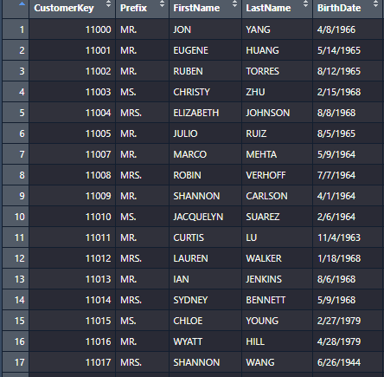
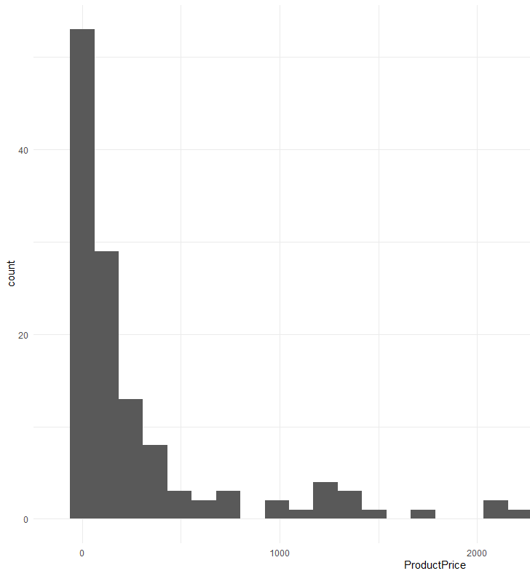
What your environment looks like
df1
a
13.4532
res_graph1
Environment
string1
“stuff”
My_function(a, b)
dplyr
dbplyr
create_data(file, …)
lubridate
data.table
list1
glue
nnet
c(“abel31”, 34, “amne”)
tidyr
ggplot2

Slide 13
Importing data
On your computer, data is usually stored in some kind of format: csv (comma-separated values), xlsx (Excel), sas7bdat (SAS file), .sav (SPSS file), .dat (Stata), .rds (R file format)
You must import it in R, but the function will change depending on the format:
CSV (most common): use read_csv() from readr package
Data files exported from statistical softwares: check haven package
Excel: read_xlsx from readxl
Example: df <- read_csv(“data/dataset.csv”)
Here, the content of the file dataset.csv is read and then stored in the object df

Slide 14
Data manipulation paradigms
In today’s (2024) R ecosystem, you have multiple families of packages and tools to manipulate data:
“Base R” (R built-in functions for data manipulation): don’t. Courses that teach this are a waste of time (in my opinion).
The Tidyverse: what is currently mainly used by R practitioners. Reasonably fast and very easy to understand. This includes packages like dplyr, ggplot2, purrr… That’s what we will use.
Data.table: Blazing fast and very memory efficient, but for more experienced R users. We will see this in a few weeks.
There are a few (specialized) others, like arrow, sparklyr, dbplyr that allow to interact with specific database management systems

Slide 15
Selecting variables, filtering data
Select: select(df, age, gender, income)
This keeps columns age, gender and income in the object df
Filter: filter(df, income >= 30000)
This keeps observations with income over or equal to 30,000 in the object df

Slide 16
Piping
Pipe operator : %>%
RStudio shortcut: Ctrl + Shift + M for Windows, or Cmd + Shift + M for Mac
This come from the magrittr package
FYI, since 2021, R has implemented its native pipe: |>
Extremely useful for chaining functions
E.g.:
df %>% select(age, income) %>% filter(income > 15000)
In human language: take object df, AND THEN (%>%) select columns age and income, AND THEN keep observations with income over 15,000

Slide 17
Modifying columns
Use mutate() to modify or add new variables:
df %>%
mutate(
date_bought = as_date(date_bought, format = “%m/%d/%Y),
age_sq = age^2,
major = case_when(
age >= 18 ~ “Major”,
age < 18 ~ “Minor”
) %>% as_factor()
)

Slide 18
Group by and summarise
To compute statistics by group, use group_by() and then summarise()
Let’s say you want to know the average income of workers according to their industry:
df %>%
group_by(industry) %>%
summarise(
mean_income = mean(income)
)

Slide 19
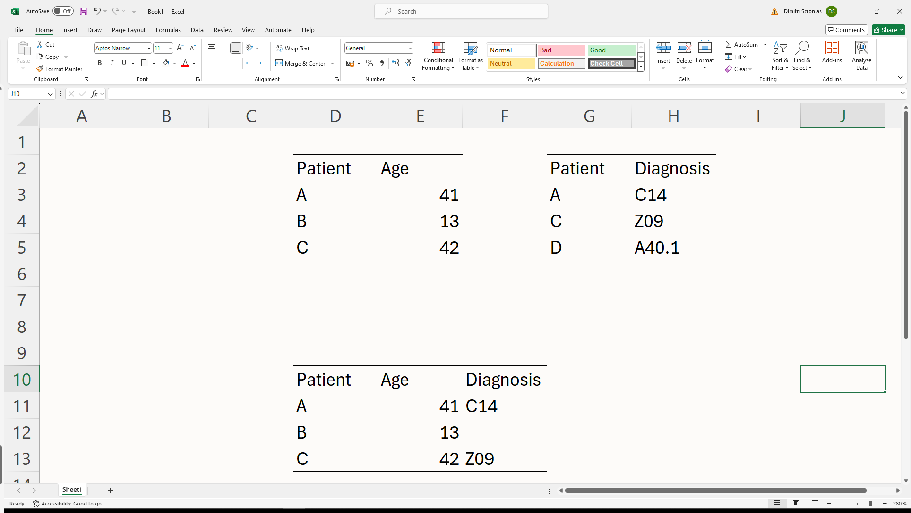
JOINS
Very important to know
Basically asked in virtually every data science interview
If I interview you, you can be sure I will ask you: what is a join, different type of joins
Used to join tabular data together:
A
B
Notes:
Must know it perfectly, should be second nature

Slide 20
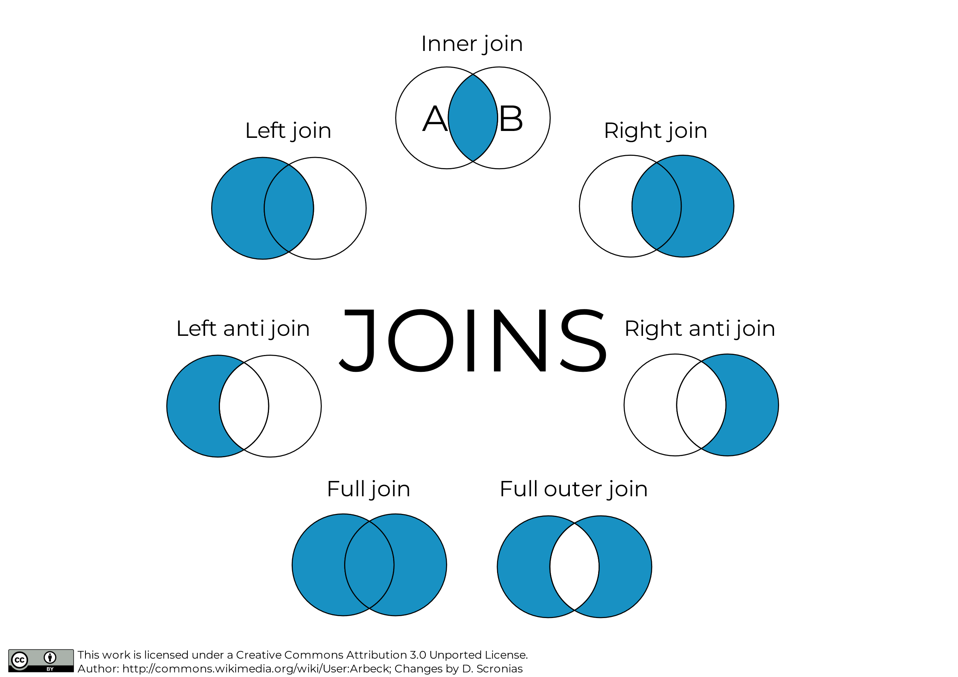
JOINS
A
Left table
B
Right table

Slide 21
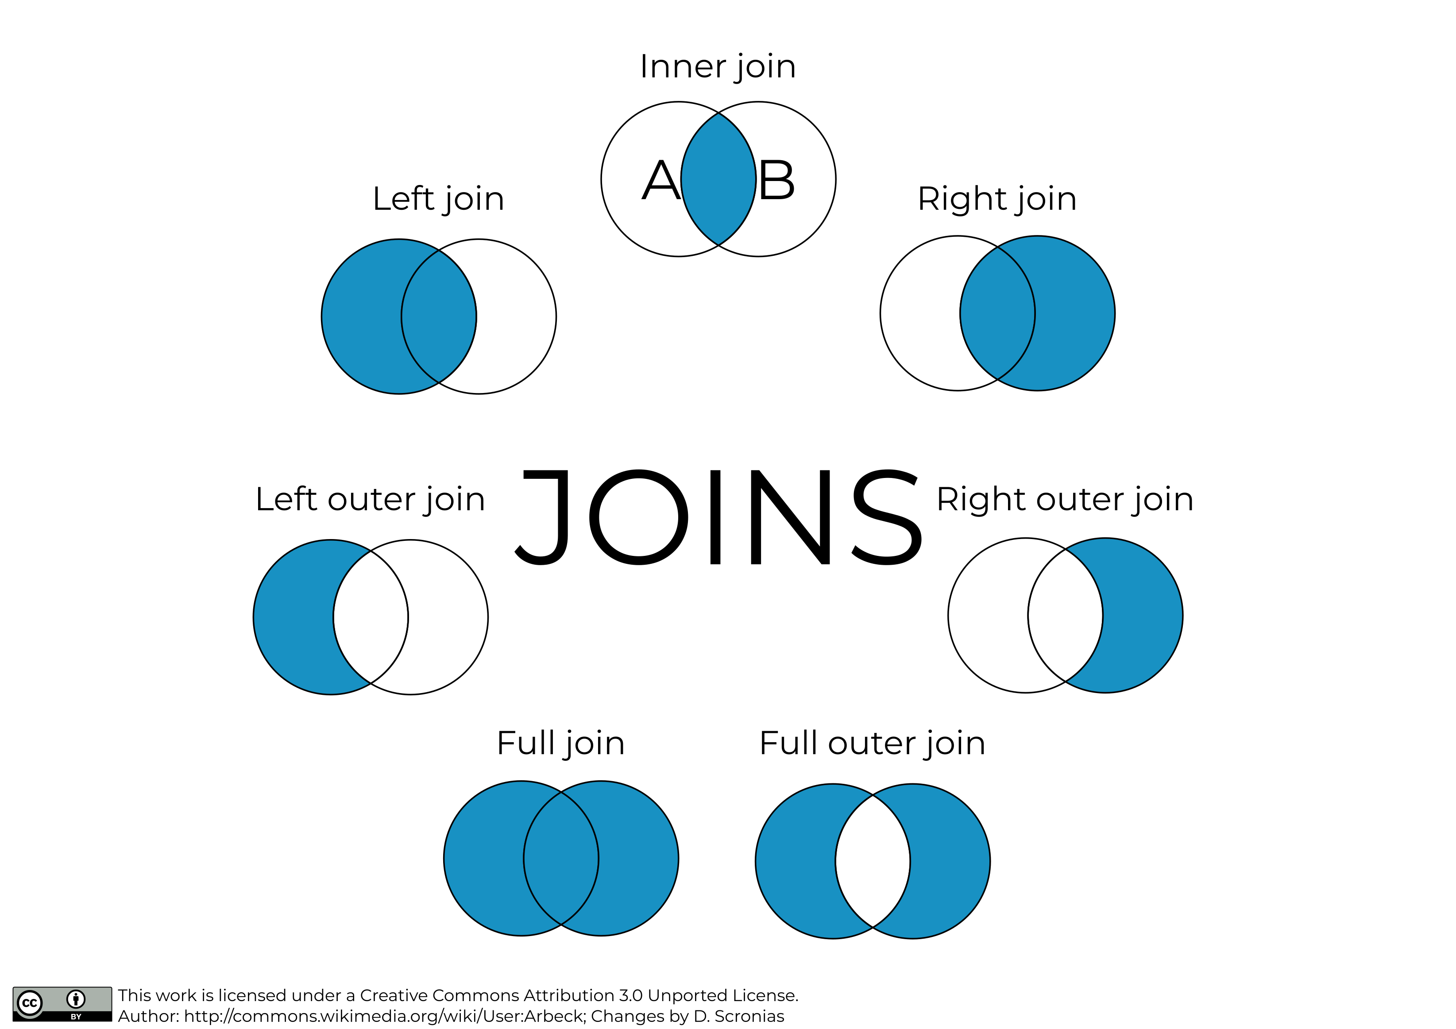
JOINS
Most common type of join, you’ll do that a lot
A
B

Slide 22
JOINS
To do a join, you need one or more common variables in both tables (keys). Here: Patient.
Notice the missing value for patient B; patient D is absent.

Slide 23
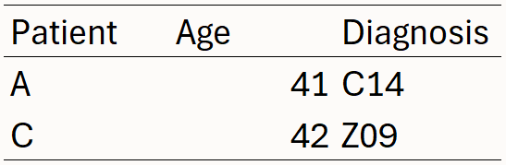
JOINS
Keep only rows in both tables
A
B

Slide 24
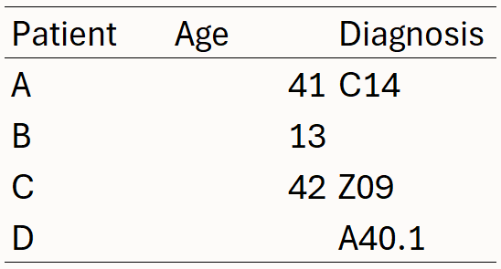
JOINS
Keep all rows
A
B

Slide 25

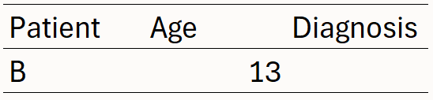
JOINS
Discard matching rows from A
A
B

Slide 26
JOINS
&
Reversed left join and left antijoin
Think about it like if table B became table A, and table A became table B.

Slide 27

JOINS
Keep all non-matching rows (never used it personally)
A
B

Slide 28
Joins: Cardinality
Cardinality: number of related rows in table B for each row in table A
Four possibilities:
1:1 – One to one
1:n – One to many
n:1 – Many to one
n:n – Many to many

Slide 29
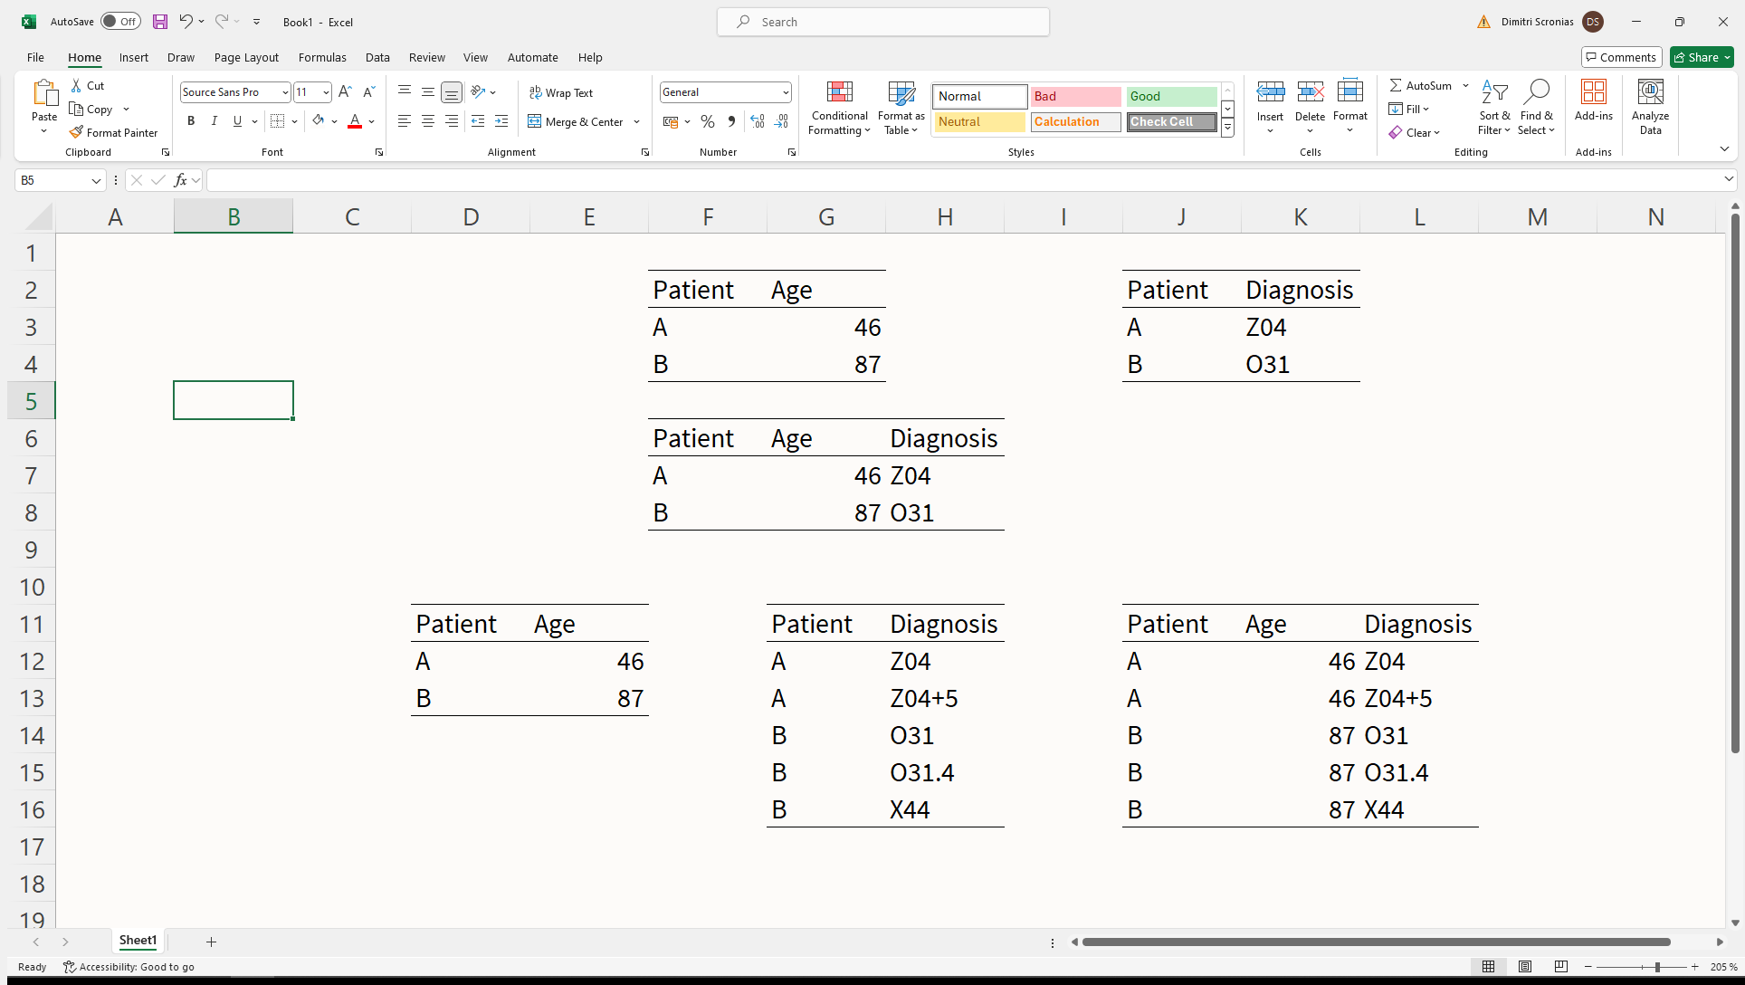
Joins: Cardinality
1
1
A
B
Number of rows should be the one from table A

Slide 30
Joins: Cardinality
1
n
A
B
Number of rows in A should increase
Notes:
For many-to-one relationships, just imagine the reverse situation: table B becomes table A, and vice-versa

Slide 31
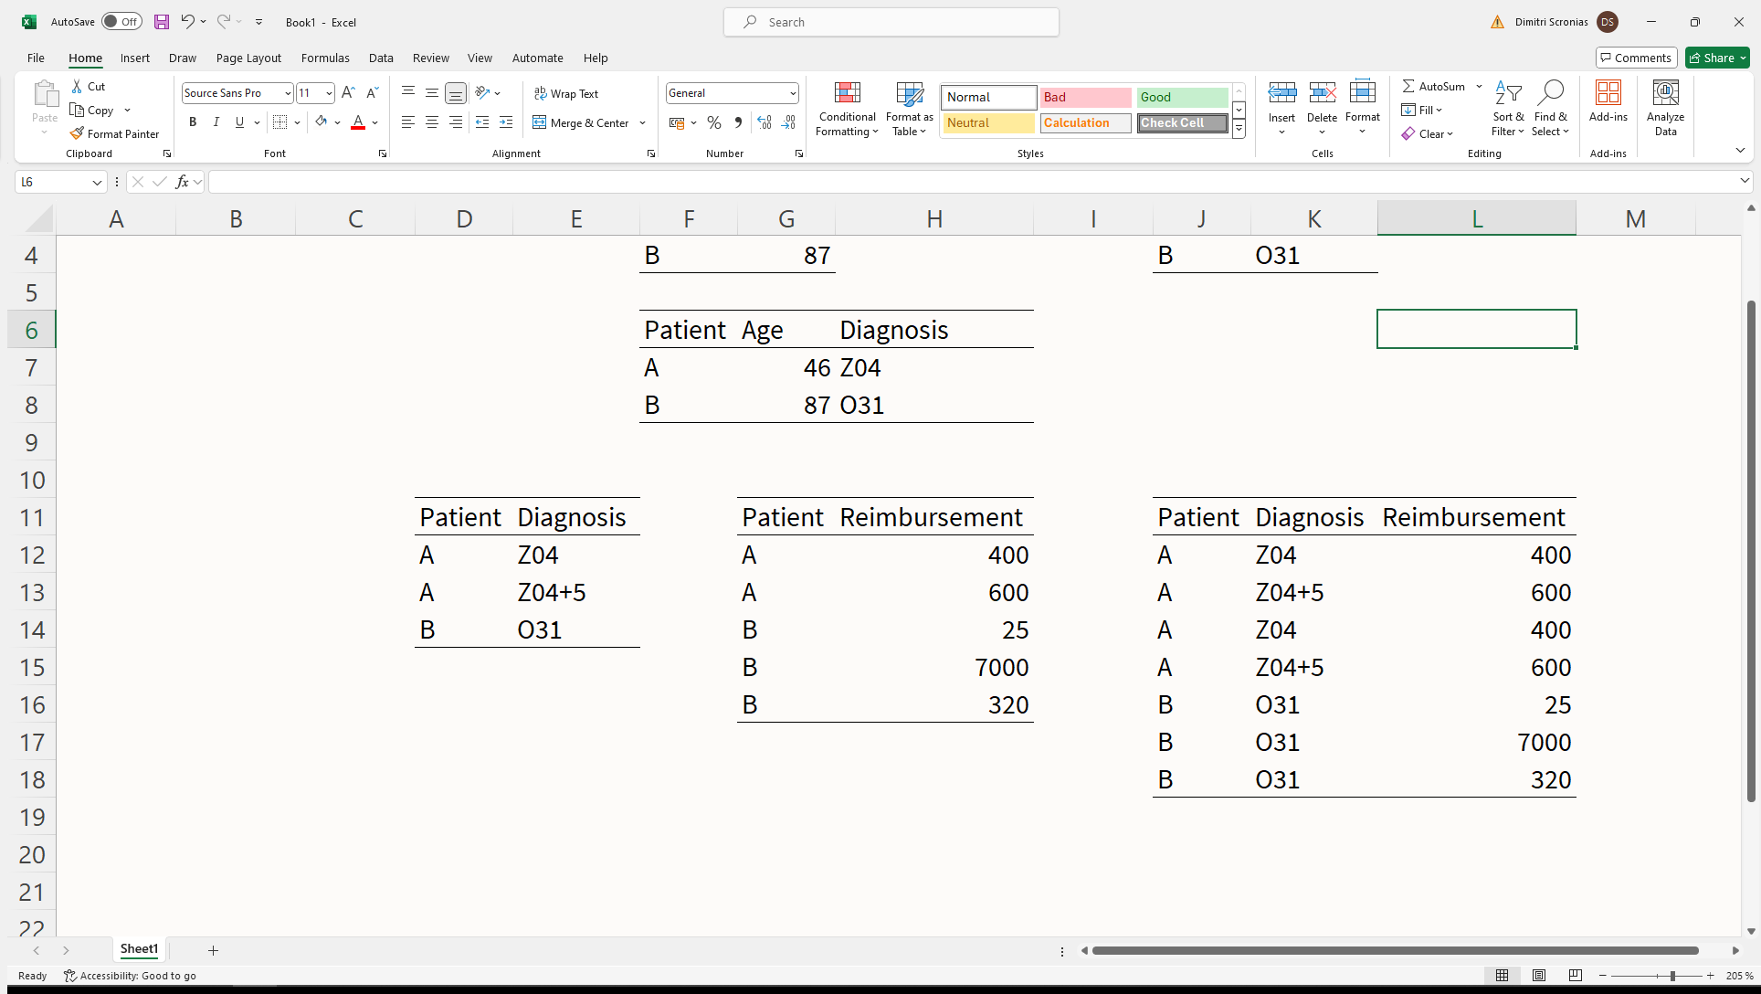
Joins: Cardinality
n
n
A
B

Slide 32
Joins: Cardinality
Quite rare: many-to-many relationships in databases are avoided (considered poor practice)
May be valid, depending on your data, but be sure that is what you intended to do

Slide 33
Joins
Joins are a basic tool and must be second nature
Becomes very easy with experience, and you will chain them like it’s nothing

Slide 34
Joins in dplyr
Use left_join(), inner_join(), full_join()
E.g.:
cohort %>%
left_join(
vaccination_status,
by = “individual_identifier”
)
The “by” argument refers to the variable that is common to both tables and that is used to perform the join (this can be multiple variables, not just one)

Slide 35
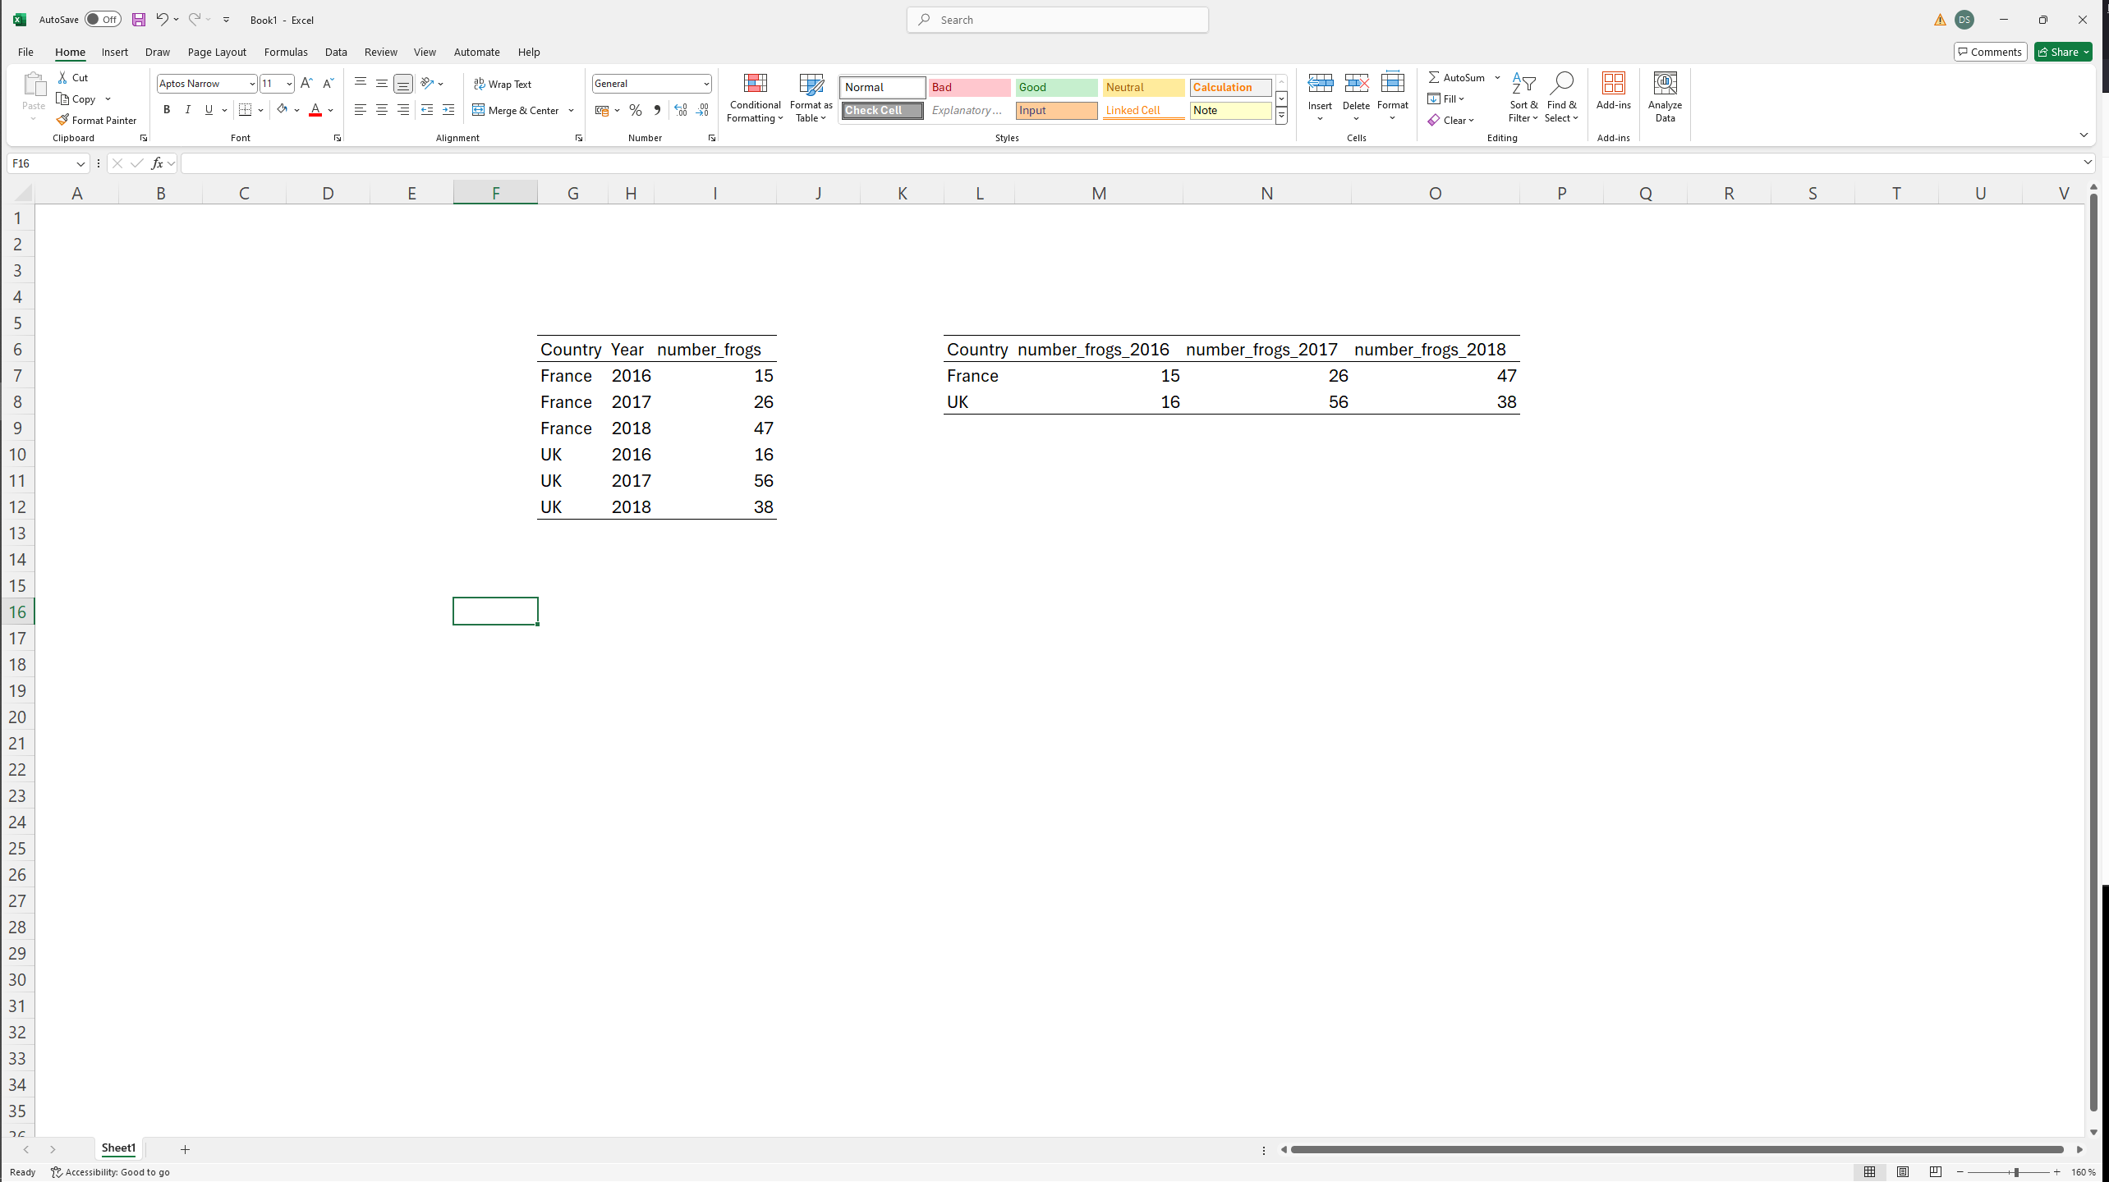
Pivoting
Pivot_wider()
Reduce number of rows, increase number of columns
Pivot_longer()
Increase number of rows, decrease number of columns
Long format
Wide format
Year categorical variable is explicit
Year categorical variable is implicit

Slide 36
Good data manipulation packages to know
Tidyverse:
Dplyr: for all your data manipulation
ggplot2: for graphs
forcats: for manipulating categorical data
stringr: for manipulating character data
purrr: advanced programming tools (when you want fast, compact code)
lubridate: manipulating dates
broom: for formatting regression results as tidy tables
janitor: for frequency tables (and some data cleaning functions)
glue: use functions inside strings (useful for programming functions)

Slide 37
AdventureWorks
Go there: https://github.com/Dscronias/DS-Real-World-Pub
Download the .docx or .pdf (the instructions) and all the data files in “Labs/Lab 1/”
Launch AdventureWorks.Rproj and get to work
Send me your work at the end of the class

